Slide 1
Module 1
Overview of operating system

Slide 2
Operating System
A program that controls the execution of application programs
An interface between applications and hardware

Slide 3
Operating System Objectives
Convenience
Makes the computer more convenient to use
Efficiency
Allows computer system resources to be used in an efficient manner
Ability to evolve
Permit effective development, testing, and introduction of new system functions without interfering with existing services.

Slide 4
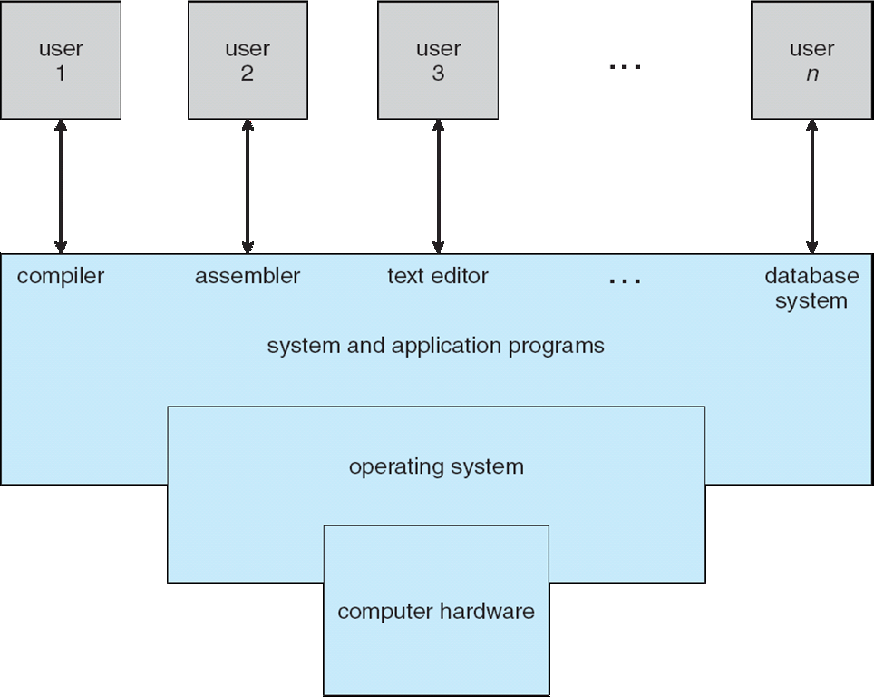
Four Components of a Computer System

Slide 5
Computer System Structure
Computer system can be divided into four components:
Hardware – provides basic computing resources
CPU, memory, I/O devices
Operating system
Controls and coordinates use of hardware among various applications and users
Application programs – define the ways in which the system resources are used to solve the computing problems of the users
Word processors, compilers, web browsers, database systems, video games
Users
People, machines, other computers

Slide 6
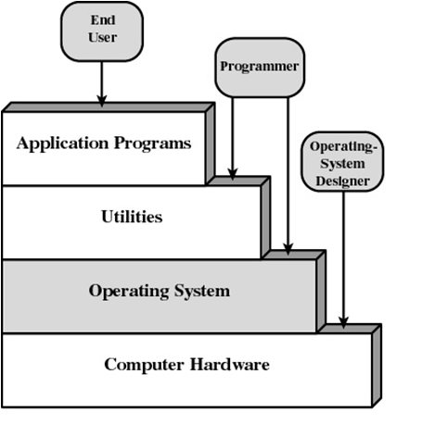
Layers and Views of Computer System
Layers and Views of a Computer System

Slide 7
Operating System Definition
OS is a resource allocator
Manages all resources
Decides between conflicting requests for efficient and fair resource use
OS is a control program
Controls execution of programs to prevent errors and improper use of the computer

Slide 8
Operating System Definition (Cont.)
No universally accepted definition
“Everything a vendor ships when you order an operating system” is good approximation
But varies wildly
“The one program running at all times on the computer” is the kernel.
Everything else is either a system program or an application program.

Slide 9
Computer Startup
bootstrap program is loaded at power-up or reboot
Typically stored in ROM or EPROM, generally known as firmware
Initializes all aspects of system
Loads operating system kernel and starts execution

Slide 10
Operating System
Functions same way as ordinary computer software
It is program that is executed
Operating system relinquishes control of the processor to execute other programs

Slide 11
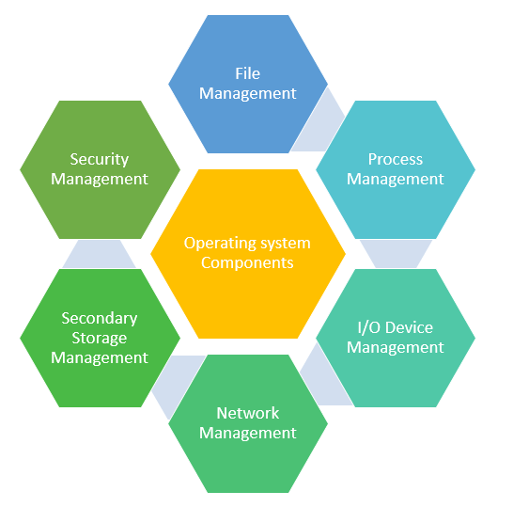
OS Components and Functions

Slide 12
Services Provided by the Operating System
Program development
Editors and debuggers
Program execution
Access to I/O devices
Controlled access to files
System access

Slide 13
Services Provided by the Operating System
Error detection and response
internal and external hardware errors
memory error
device failure
software errors
arithmetic overflow
access forbidden memory locations

Slide 14
Services Provided by the Operating System
Accounting
collect statistics
monitor performance
used to anticipate future enhancements
used for billing users (potentially)

Slide 15
Interfaces

Slide 16
User Operating System Interface - CLI
CLI or command interpreter allows direct command entry
Sometimes implemented in kernel, sometimes by systems program
Sometimes multiple flavors implemented – shells
Primarily fetches a command from user and executes it
Sometimes commands built-in, sometimes just names of programs
If the latter, adding new features doesn’t require shell modification

Slide 17
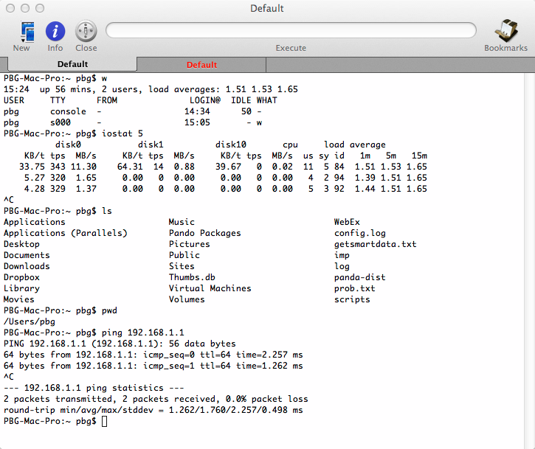
Bourne Shell Command Interpreter

Slide 18
User Operating System Interface - GUI
User-friendly desktop metaphor interface
Usually mouse, keyboard, and monitor
Icons represent files, programs, actions, etc
Various mouse buttons over objects in the interface cause various actions (provide information, options, execute function, open directory (known as a folder)
Invented at Xerox PARC
Many systems now include both CLI and GUI interfaces
Microsoft Windows is GUI with CLI “command” shell
Apple Mac OS X is “Aqua” GUI interface with UNIX kernel underneath and shells available
Unix and Linux have CLI with optional GUI interfaces (CDE, KDE, GNOME)

Slide 19
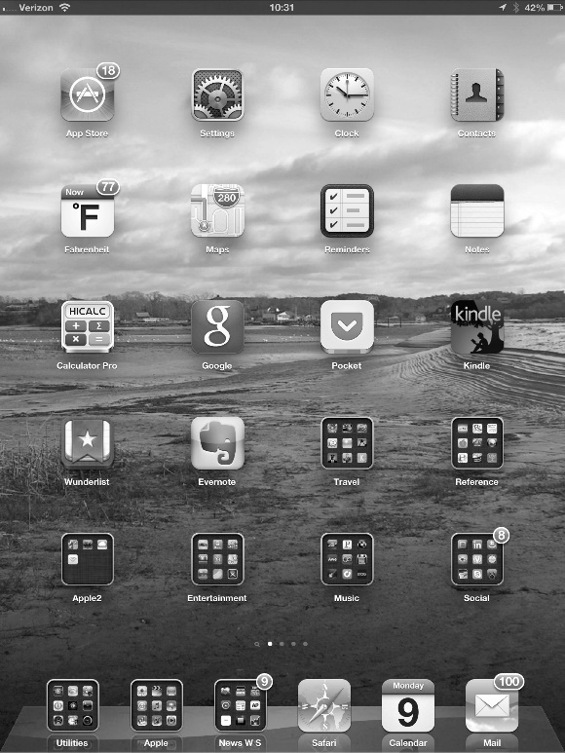
Touchscreen Interfaces
Touchscreen devices require new interfaces
Mouse not possible or not desired
Actions and selection based on gestures
Virtual keyboard for text entry
Voice commands.

Slide 20
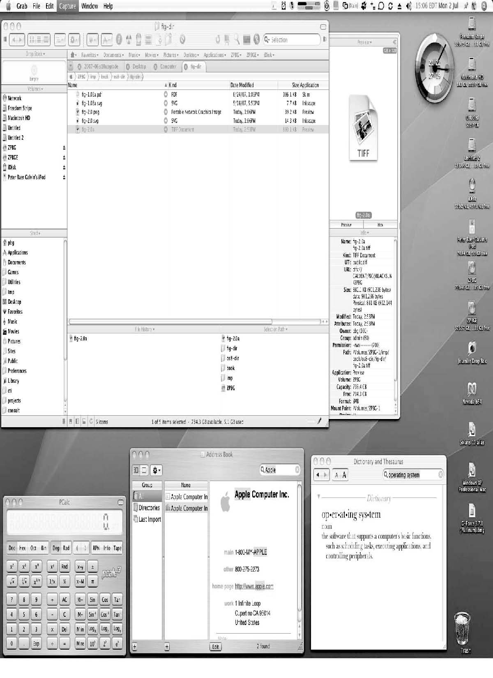
The Mac OS X GUI

Slide 21
System Programs

Slide 22
System Programs
System programs provide a convenient environment for program development and execution. They can be divided into:
File manipulation
Status information sometimes stored in a File modification
Programming language support
Program loading and execution
Communications
Background services
Application programs
Most users’ view of the operation system is defined by system programs, not the actual system calls

Slide 23
System Programs
Provide a convenient environment for program development and execution
Some of them are simply user interfaces to system calls; others are considerably more complex
File management - Create, delete, copy, rename, print, dump, list, and generally manipulate files and directories
Status information
Some ask the system for info - date, time, amount of available memory, disk space, number of users
Others provide detailed performance, logging, and debugging information
Typically, these programs format and print the output to the terminal or other output devices
Some systems implement a registry - used to store and retrieve configuration information

Slide 24
System Programs (Cont.)
File modification
Text editors to create and modify files
Special commands to search contents of files or perform transformations of the text
Programming-language support - Compilers, assemblers, debuggers and interpreters sometimes provided
Program loading and execution- Absolute loaders, relocatable loaders, linkage editors, and overlay-loaders, debugging systems for higher-level and machine language
Communications - Provide the mechanism for creating virtual connections among processes, users, and computer systems
Allow users to send messages to one another’s screens, browse web pages, send electronic-mail messages, log in remotely, transfer files from one machine to another

Slide 25
System Programs (Cont.)
Background Services
Launch at boot time
Some for system startup, then terminate
Some from system boot to shutdown
Provide facilities like disk checking, process scheduling, error logging, printing
Run in user context not kernel context
Known as services, subsystems, daemons
Application programs
Don’t pertain to system
Run by users
Not typically considered part of OS
Launched by command line, mouse click, finger poke

Slide 26
System Calls

Slide 27
System Calls
Programming interface to the services provided by the OS
Typically written in a high-level language (C or C++)
Mostly accessed by programs via a high-level Application Programming Interface (API) rather than direct system call use
Three most common APIs are Win32 API for Windows, POSIX API for POSIX-based systems (including virtually all versions of UNIX, Linux, and Mac OS X), and Java API for the Java virtual machine (JVM)

Slide 28
System Call
A system call is how a process requests a service from an operating system's kernel.
This may include
Hardware related services (e.g. accessing the hard disk)
Creating and executing new processes
Communicating with integral kernel services (like scheduling).
System calls are interface between a user process and the system.

Slide 29
System Call Categories
System calls can be roughly grouped into five major categories:
Process Control
File management
Device Management
Information Maintenance
Communication

Slide 30
System Call Categories
Process Control
load
execute
create process (for example, fork on Unix-like systems or NtCreateProcess in the Windows NT Native API)
terminate process
get/set process attributes
wait for time, wait event, signal event
allocate, free memory

Slide 31
System Call Categories
File management
create file, delete file
open, close
read, write, reposition
get/set file attributes
Device Management
request device, release device
read, write, reposition
get/set device attributes
logically attach or detach devices

Slide 32
System Call Categories
Information Maintenance
get/set time or date
get/set system data
get/set process, file, or device attributes
Communication
create, delete communication connection
send, receive messages
transfer status information
attach or detach remote devices

Slide 33
OS Evolution

Slide 34
Evolution of an Operating System
When
Hardware upgrades and new types of hardware
New services
Fixes

Slide 35
Serial Processing
No operating system
Machines run from a console with display lights and toggle switches, input device, and printer
Schedule tome (book)
Setup included loading the compiler, source program, saving compiled program, and loading and linking

Slide 36
Simple Batch Systems
Monitors
Software that controls the running programs
Batch jobs together
Program branches back to monitor when finished
Resident monitor is in main memory and available for execution
Job Control Language (JCL)
Special type of programming language
Provides instruction to the monitor
what compiler to use
what data to use

Slide 37
Simple Batch Systems
Hardware Features
Memory protection
do not allow the memory area containing the monitor to be altered
Timer
prevents a job from monopolizing the system

Slide 38
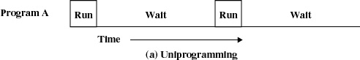
Uniprogramming
Processor must wait for I/O instruction to complete before preceding

Slide 39
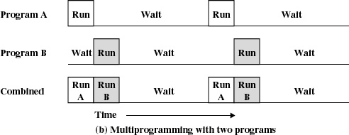
Multiprogramming
When one job needs to wait for I/O, the processor can switch to the other job

Slide 40
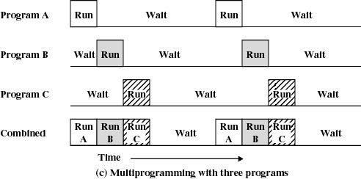
Multiprogramming

Slide 41
Time Sharing
Using multiprogramming to handle multiple interactive jobs
Processor’s time is shared among multiple users
Multiple users simultaneously access the system through terminals

Slide 42
OS Architecture

Slide 43
Operating Systems Architectures (Kernel Architectures)
Operating systems tend to be complex
Provide many services
Support variety of hardware and software
Operating system architectures help manage this complexity
Organize operating system components
( e.g. Memory Management, Process Scheduler, IPC, File System , I/O Controllers, Network Managers … )
Specify privilege with which each component executes

Slide 44
Kernel
Also called the nucleus
Portion of operating system that is in main memory
Functionalities
Primary function is to mediate access to the computer’s resources, including
The Central Processing Unit (CPU)
Random Access Memory
Input/output (I/O) devices
Kernels also usually provide methods for synchronization and communication between processes called inter-process communication (IPC).
Memory Management.
Virtual Addressing (paging and/or segmentation)

Slide 45
Kernel
Kernel is the core of Operating System
All the functionalities of an OS may be included in this core.
This leads to different types of Kernels or Kernel Architecture.
(In modern Operating Systems) User processes don’t have direct control over system resources.
To accomplish a task the processes make requests to the kernel.
These requests are called System Calls.

Slide 46
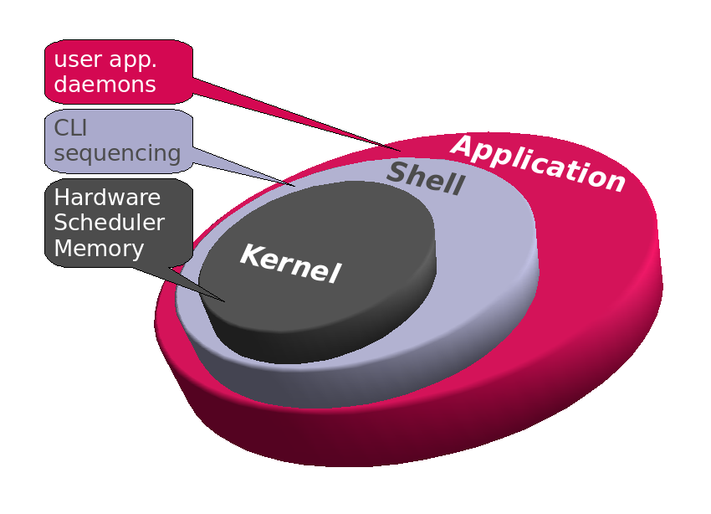
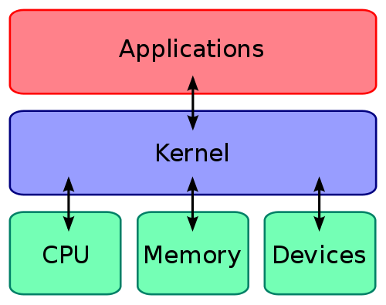
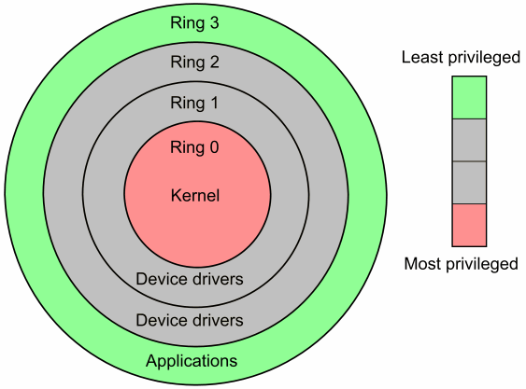
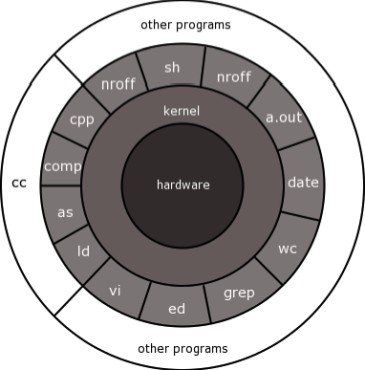
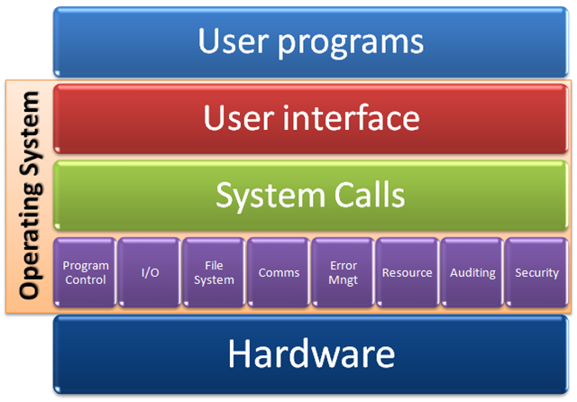
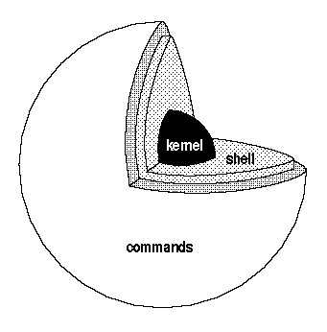
Kernel (Different Representations)
Source : Google Images

Slide 47
Kernel Architectures
Monolithic
Layered
Micro-kernel
Distributed

Slide 48
Monolithic Architecture
Monolithic operating system
Every component contained in kernel
Direct communication among all elements
Highly efficient
Problems:
Complexity
New devices, emerging technologies
E.g. DOS

Slide 49
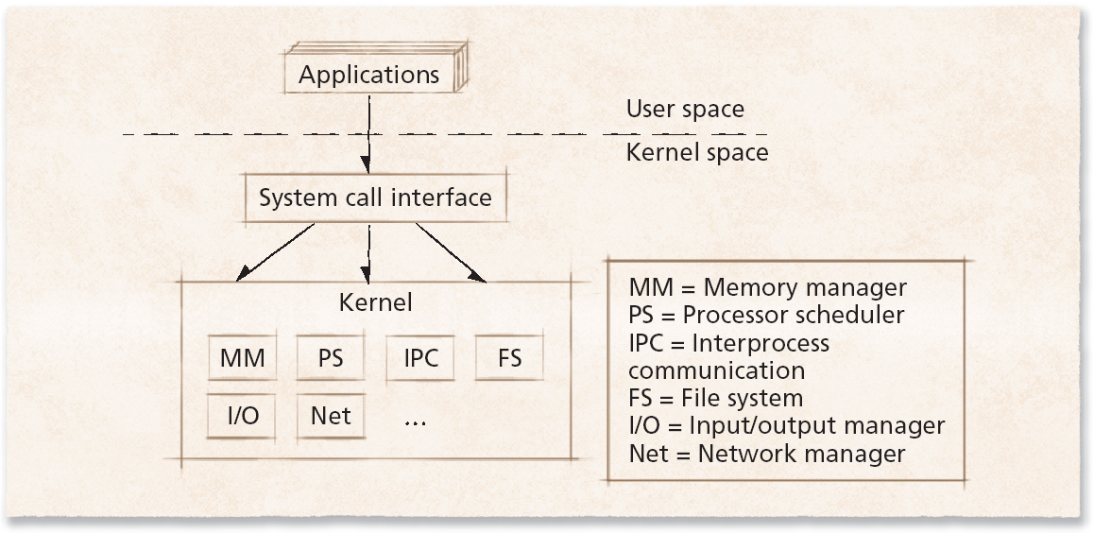
Monolithic Architecture

Slide 50
Layered Architecture
Groups components that perform similar functions into layers
Each layer communicates only with adjacent layer
System calls might pass through many layers before completion
Drawback : Low application performance.
E.g. Unix

Slide 51
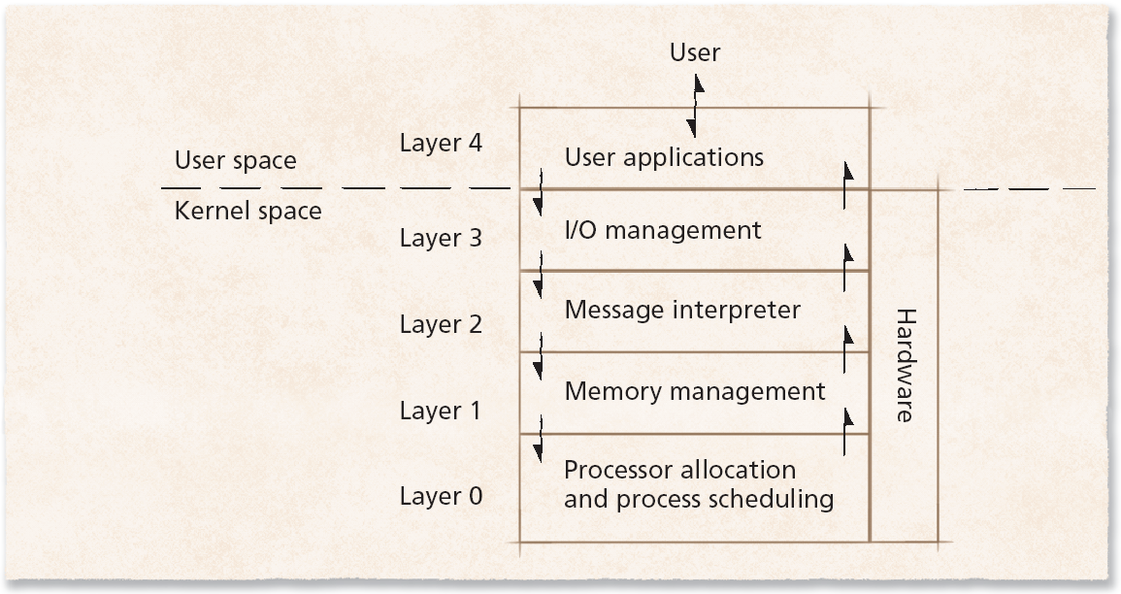
Layered Architecture

Slide 52
Microkernel System Structure
Microkernel
provides only small number of services
attempt to keep kernel small and scalable
Moves as much from the kernel into user space
Mach is example of microkernel
Mac OS X kernel (Darwin) partly based on Mach
Communication takes place between user modules using message passing
Benefits:
Easier to extend a microkernel
Easier to port the operating system to new architectures
More reliable (less code is running in kernel mode)
More secure
Detriments:
Performance overhead of user space to kernel space communication

Slide 53
Microkernel System Structure

Slide 54
Distributed Operating Systems
Network operating system
Runs on one computer but allows its processes to access remote resources
Distributed operating system
Single OS manages resources on more than one computer

Slide 55
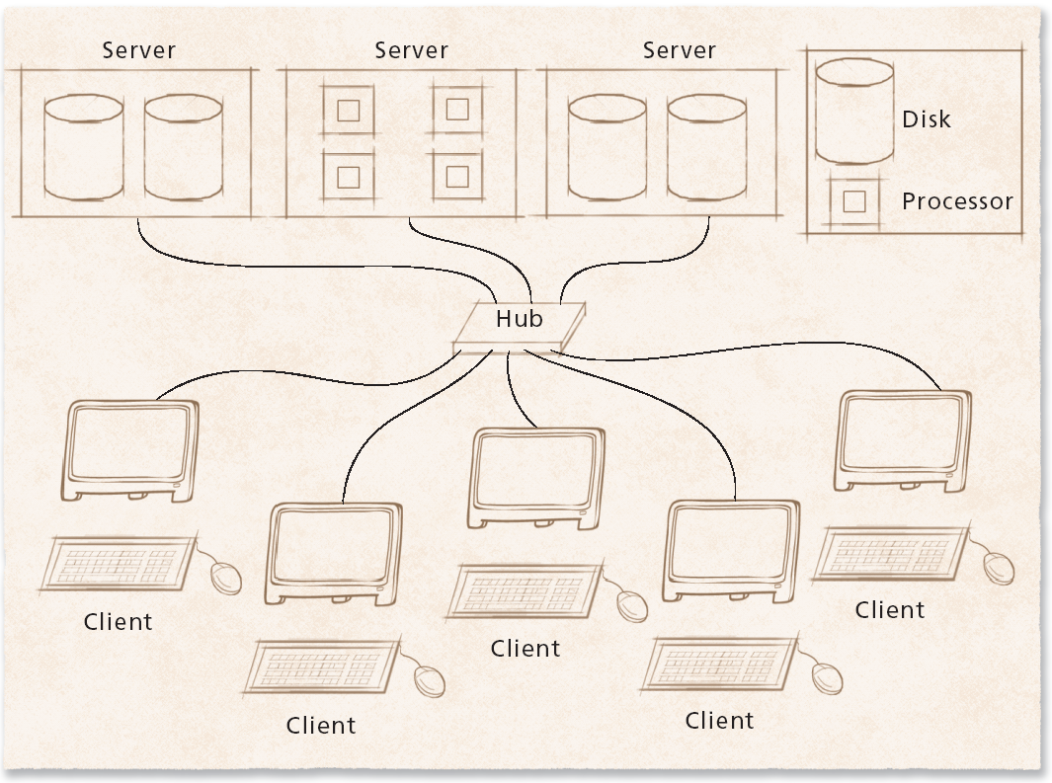
Distributed Operating Systems

Slide 56
Linux Kernel Architecture
Monolithic kernel:
Contains modular components
Process management
Interprocess communication
Memory management
File system management
VFS: provides a single file system interface
I/O management
Networking

Slide 57
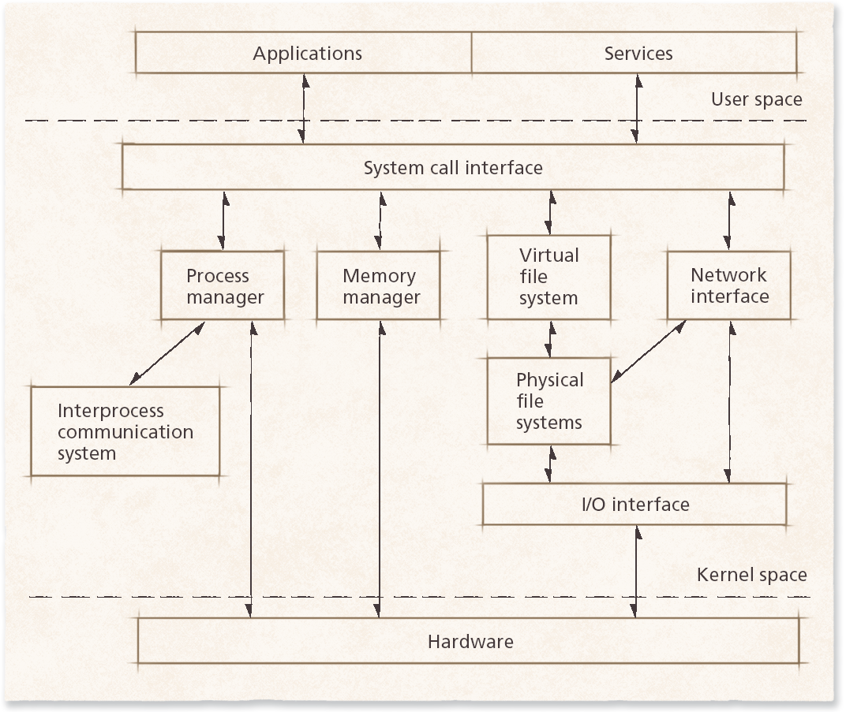
Linux Kernel Architecture

Slide 58
Characteristics of Modern OS

Slide 59
Characteristics of Modern Operating Systems
Microkernel architecture
assigns only a few essential functions to the kernel
address space
interprocess communication (IPC)
basic scheduling

Slide 60
Characteristics of Modern Operating Systems
Multithreading
process is divided into threads that can run simultaneously
Thread
dispatchable unit of work
executes sequentially and is interruptable
Process is a collection of one or more threads

Slide 61
Characteristics of Modern Operating Systems
Symmetric multiprocessing
there are multiple processors
these processors share same main memory and I/O facilities
All processors can perform the same functions

Slide 62
Characteristics of Modern Operating Systems
Distributed operating systems
provides the illusion of a single main memory and single secondary memory space
used for distributed file system

Slide 63
Characteristics of Modern Operating Systems
Object-oriented design
used for adding modular extensions to a small kernel
enables programmers to customize an operating system without disrupting system integrity

Slide 64
Operation Modes
Kernel Mode
User Mode

Slide 65
Kernel Mode of Operation
Also referred as System Mode.
In Kernel mode, the executing code has complete and unrestricted access to the underlying hardware.
It can execute any CPU instruction and reference any memory address.
Kernel mode is generally reserved for the lowest-level, most trusted functions of the operating system.
Supported by Hardware Designs
Crashes in kernel mode are catastrophic.

Slide 66
User Mode of Operation
The executing code has no ability to directly access hardware or reference memory.
Code running in user mode must delegate to system APIs to access hardware or memory.
Due to the protection afforded by this sort of isolation, crashes in user mode are always recoverable.
Most of the user applications run in this mode.

Slide 67
Extra

Slide 68
Major Achievements of Modern OS
Processes
Memory Management
Information protection and security
Scheduling and resource management
System structure

Slide 69
Processes
A program in execution
An instance of a program running on a computer
The entity that can be assigned to and executed on a processor
A unit of activity characterized by a single sequential thread of execution, a current state, and an associated set of system resources

Slide 70
Difficulties with Designing System Software
Improper synchronization
ensure a process waiting for an I/O device receives the signal
Failed mutual exclusion
Nondeterminate program operation
program should only depend on input to it, not relying on common memory areas
Deadlocks

Slide 71
Process
Consists of three components
An executable program
Associated data needed by the program
Execution context of the program
All information the operating system needs to manage the process

Slide 72
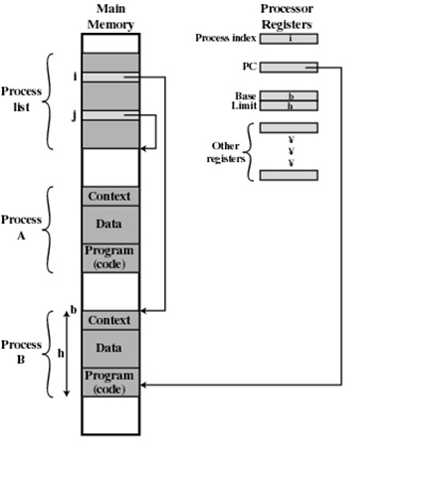
Process

Slide 73
Memory Management
Process isolation
Deny interference
Automatic allocation and management
Dynamic and efficient memory allocation
Transparent to programmer
Support for modular programming
Protection and access control
OS must allow access of portions of memory, to various users in various ways.
Long-term storage
Keeping processes in memory even when the system is down.

Slide 74
Virtual Memory
Allows programmers to address memory from a logical point of view
While one process is written out to secondary store and the successor process read in there in no hiatus

Slide 75
File System
Implements long-term store
Information stored in named objects called files

Slide 76
Paging
Allows process to be comprised of a number of fixed-size blocks, called pages
Virtual address is a page number and an offset within the page
Each page may be located any where in main memory
OS provides mapping between virtual address and real address (or physical address) in main memory

Slide 77
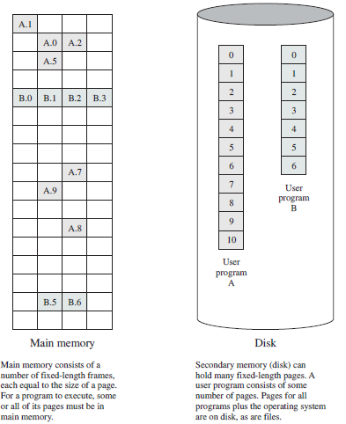

Slide 78
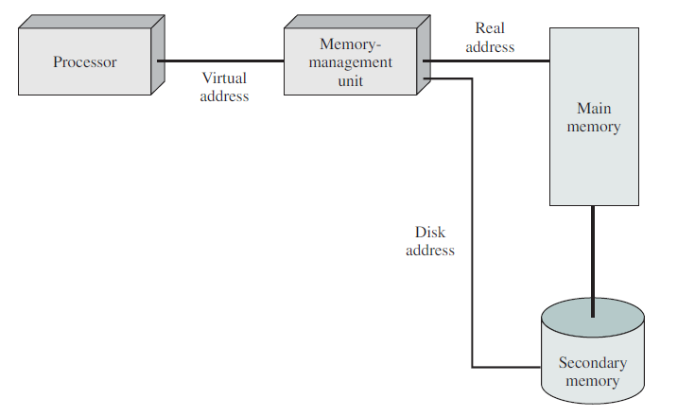
Virtual Memory Addressing

Slide 79
Information Protection and Security
Access control
regulate user access to the system
Information flow control
regulate flow of data within the system and its delivery to users
Certification
proving that access and flow control perform according to specifications

Slide 80
Scheduling and Resource Management
Fairness
give equal and fair access to all processes
Differential responsiveness
discriminate between different classes of jobs
Efficiency
maximize throughput, minimize response time, and accommodate as many uses as possible

Slide 81
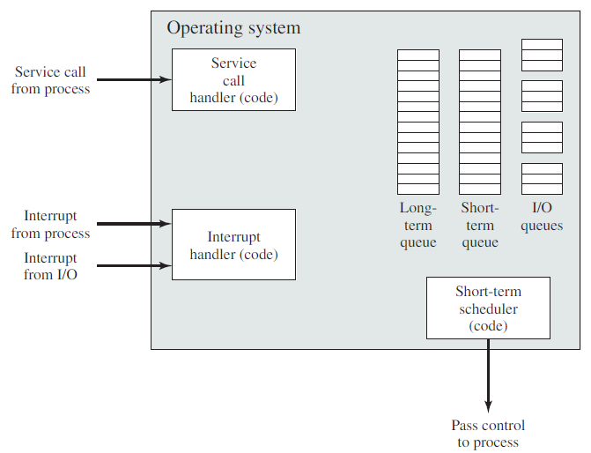
Major Elements of Operating System

Slide 82
System Structure
View the system as a series of levels
Each level performs a related subset of functions
Each level relies on the next lower level to perform more primitive functions
This decomposes a problem into a number of more manageable subproblems

Slide 83
Operating System Design Hierarchy
Level Name Objects Example Operations
13 Shell User programming Statements in shell language
environment
12 User processes User processes Quit, kill, suspend, resume
11 Directories Directories Create, destroy, attach, detach,
search, list
10 Devices External devices, such Open, close,
as printer, displays read, write
and keyboards
9 File system Files Create, destroy, open, close
read, write
8 Communications Pipes Create, destroy, open. close,
read, write

Slide 84
Operating System Design Hierarchy
Level Name Objects Example Operations
7 Virtual Memory Segments, pages Read, write, fetch
6 Local secondary Blocks of data, device Read, write, allocate, free
store channels
5 Primitive processes Primitive process, Suspend, resume, wait, signal
semaphores, ready
list

Slide 85
Operating System Design Hierarchy
Level Name Objects Example Operations
4 Interrupts Interrupt-handling Invoke, mask, unmask, retry
programs
Procedures Procedures, call stack, Mark stack, call, return
display
2 Instruction Set Evaluation stack, micro- Load, store, add, subtract
program interpreter, branch
scalar and array data
1 Electronic circuits Registers, gates, buses, Clear, transfer, activate,
etc. complement

